Slide 1
Lecture 24:
6.3. Populism, Plutocracy, Kleptocracy, & Neo-Fascism
Brad DeLong
Department of Economics & Blum Center, U.C. Berkeley; & WCEG
last revised: Su 2020-04-12
for presentation: Th 2020-04-30
Original course by Melissa Dell (Harvard Econ 1342), revised by Brad DeLong
<https://github.com/braddelong/public-files/blob/master/econ-135-lecture-24.pptx>

Slide 2
Discussion
Populism, Plutocracy, Kleptocracy, & Neo-Fascism:
What strikes you as important here?

Slide 3
Populism, Plutocracy, Kleptocracy, & Neo-Fascism
Th Apr 30: 6.4. Populism, Plutocracy, Kleptocracy, & Neo-Fascism:
Read Before: Ernest Gellner (1973): Nations & Nationalism, selections <https://github.com/braddelong/public-files/blob/master/readings/book-selections-gellner-nationalism.pdf>
Read Before: Barry Eichengreen (2018): The Populist Temptation Economic Grievance & Political Reaction in the Modern Era, selections <https://delong.typepad.com/files/eichengeeen-populist.pdf>
Discussion Thread: <https://bcourses.berkeley.edu/courses/1487685/discussion_topics/5756990>
24:00 minutes of audio

Slide 4
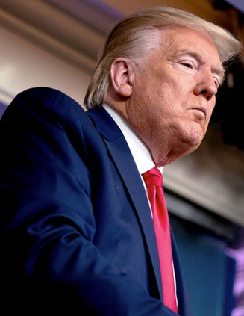

Technocratic Default
Donald Trump’s Trade Policy:
NAFTA “worst trade deal ever”
Must renegotiate!
TPP “second worst ever”
Must shut it down!
USMTA = NAFTA + TPP + auto-parts rules-of-origin
BEST TRADE DEAL EVER!
Trade war with China
Start by disarming…
3:15
Notes:
The past 20 years appear to have been the worst for economic growth in the global north since at least 1865. One view is that properly-measured growth has in fact been OK, if inequitable and accompanied by rising income and wealth inequality, but that large scale anxiety has been generated because the social wage produced by feeling superior to others—to women, to minorities, to foreigners—has been diminished by moves toward equality of opportunity. A second view is that the global north has hit a rough patch, and the true technological and organizational progress is now harder and has been slow down.
A third view is that governance has shifted: away from a focus on supporting economic growth and toward a combination of an expression of social difference linked with upward redistribution accompanied by a relative unconcern with supporting and encouraging economic growth, or indeed with having policies that work. This third view is that the global north, especially the United States, is and has for twenty years been gradually sliding into a position of technocratic default.
We can see this most strongly in the trade policy of Donald Trump. Donald Trump ran very strongly on the claim that NAFTA had been the worst trade deal ever, and that Americans had been taken to the cleaners by Mexicans. We must re-negotiate it to make it fair! Donald Trump ran very strongly on the claim that the Trans Pacific Partnership was the second worst trade deal ever and that Americans had been taken to the cleaners by… well, it was not clear, since we had gotten pretty much everything we asked for in the negotiation, and China was not a party. It must be blown up!
But when it came time to renegotiate NAFTA, neither Trump nor any of his advisers or propagandists could think of anything to ask for. So the renegotiated NAFTA—the USMTA—consists of the old NAFTA, plus most of the TPP provisions (which now bind us, Canada, and Mexico, but not the others who are party to their own but not to our agreement), plus some auto parts rules of origen provisions that has always been a high priority for midwestern Democrats from Ohio and Michigan and had always been strongly opposed by the Republican party. Go figure.
And when it came time for Trump to wage his trade war with China over intellectual property protection and market access issues, the Chinese negotiators pointed out that if Trump had signed the TPP and had then demanded that China respect the TPP intellectual property and market access rules in its dealings with all TPP members, he would have had considerable leverage. The TPP are, after all, an overwhelming part of China’s total trade. The U.S. is important, but not overwhelming. The Chinese negotiators said: if you were serious, you would have signed the TPP and then come to negotiate with us from a position of strength. Instead, you unilaterally threw away your leverage, and now you ask us to make concessions? Without the TPP partners to back you up, a trade war will be much worse for you than it will be for us. Go figure.

Slide 5
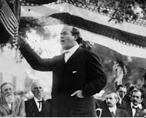
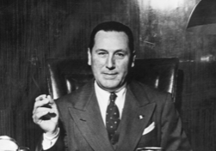
Earlier “Populists” Had Plans!
American populists:
Free coinage of silver at 16-to-1
An ICC to control railroad rates
Farmer cooperatives
Antitrust
Farmer-labor alliance
William Jennings Bryan: “Thou shalt not press down upon the brow of labor this crown of thorns; thou shalt not crucify mankind upon a cross of gold”
Some of these made sense; others did not
Latin American populists:
Government jobs for the boys
ISI at the expense of landed export interests
Borrow-and-spend
Use price controls to stem inflation
Some of these made sense, others did not
2:15
Notes:
Trump, and similar politicians like Boris Johnson in Britain, VIktor Orban in Hungary, Nahendra Modi in India, and so forth, are often called “populist”. But that does not seem to me to really fit. Earlier “populists” had plans, and theories about the economy and how to make it better!
In America, populists like William Jennings Bryan had a definite set of strong policy demands for how to rebalance wealth in favor of American people and away from the bankers, the plutocrats, the Kleptocrats, the monopolists, and other rich unworthy. William Jennings Bryan's populists demanded the free coinage of silver into currency at a value 1/16 that of gold in order to expand the money supply and lower interest rates. They demanded an interstate commerce commission does set railroad rates low so that Americans could sell their crops fairly at fair prices to those who would then carry them to the cities where they were demanded. They demanded farmers cooperative so that farmers would have bargaining power in their dealings. They demanded the break up of monopolies and trusts. They sought a farmer labor alliance. William Jennings Bryan expressed all of this inspiring rhetoric: "thou shall not press down upon the brow of labor this crown of thorns; thou shall not crucify mankind upon a cross of gold!” But there were underlying demands for large policy changes in what the populists thought was a pro growth direction. And some of their policy demands made technocratic sense, while some did not.
Later on, Latin American populists similarly had a strong set of policy demands in order to get rid of the internal colonization of Latin American economies by Castillian-descended landed elites that they believe had hobbled growth. They sought the government to turn its positions in the industry it nationalized into a source of jobs for a drive toward full employment. They sought import substitution industrialization at the expense of landed export interests. They sought low interest rates and expanded money supplies to produce full employment, and they hoped that price control programs could then stem inflation. Once again, some of these made technocratic sense. Others did not.

Slide 6
Identifying the Enemies of the Nation
Yes, earlier populists had identified enemies…
Monopolists…
Bankers…
Rich & poor foreigners…
Yes, not a Marxist class skew, particularly—there were malefactors of great wealth, but also malefactors of little wealth
The enemies were those who had set themselves in opposition to the “people”
And who had wreaked policies that impoverished the “people”
This seems different: A Viktor Orban or a Boris Johnson or a Donald Trump is not interested in economic policies
They are interested in power, and in identifying enemies
And (secondarily?) in plutocracy/kleptocracy…
2:00
Notes:
Instead of focusing on economic growth, or even on redistribution to give the people a fair shake and more opportunity in the economy, this current of politics in the global north and elsewhere, which has been gathering strength over the past generation, seems to be focused on identifying enemies of the nation, and then giving the enemies of the nation what they deserve.
Yes, earlier populists had identified enemies: monopolists, bankers, rich foreigners, poor foreigners, and so forth. And yet there had not particularly been a Marxist class skew. There were malefactors of great wealth. And there were malefactors of little wealth. There were those who charged too much for what they sold. And there were those who offered to work for too little. The enemies were those who set themselves in opposition to the people, and who had wreaked policies that impoverished the people.
This seems different. The enemy is identified by Trump, Johnson, and company are not enemies of the people because they wreak policies that make the people poor. They are enemies of the people because they are… enemies.
This current wave seem to be interested in power, and identifying enemies. And if they have interests in economic policies, they are interested in policies that redistribute wealth to their friends and to the rich—in kleptocracy and sometimes plutocracy. This last, however, seems far more prominent in Donald Trump than in the others, however: Trump has embraced upward redistribution to plutocrats via tax cuts for the rich end more polluted air and water. The others seem to want to enrich their circles of friends and supporters, but not to be on the side of "the Rich" in general.

Slide 7
Ernest Gellner’s Argument
Nationalism is a theory of political legitimacy:
Those not of the right ethnos should not hold political power
Claims that a leader should be replaced fall if he can establish that he is from and is working for the right ethnos
Those who want opportunity and position had better be of the right ethnos as well
Policies have an ethnic skew—which is really an ascribed cultural skew notionally based on (fictitious) descent—not a class or a technocratic one:
“Ezekiel Moreno, 35, a Navy veteran… accepted in WorkAdvance.… That training led him to a job at M&M Manufacturing, which makes aerospace parts, and to steady pay increases. ‘We’ve moved out of an apartment and into a house,. My daughter is taking violin lessons, and my other daughter has a math tutor.’ Moreno was sitting at a table with his boss, Rocky Payton.… All said they had voted for Trump… were bewildered that he wanted to cut funds that channel people into good manufacturing jobs. ‘There’s a lot of wasteful spending, so cut other places,’ Moreno said. Payton suggested that if the government wants to cut budgets, it should target ‘Obama phones’ provided to low-income Americans. (In fact, the program predates President Barack Obama and is financed by telecom companies rather than by taxpayers.)… I was struck by how loyal they remain to Trump…”
3:00
Notes:
What is going on? I think what is going on is the mobilization by political entrepreneurs of currents of thought and feeling. The interest is not so much of growing the economy. The interest is not even one of redistributing wealth and opportunity to one class or the other. Rather, the interest is one of political entrepreneurs in finding a way to achieve and hold power in spite of a lack of commitment to economic policies that would be broadly wealth-creating and distributing, and thus broadly popular.
And this mobilization is based on nationalism.
As Ernest Gellner puts it, nationalism is at its bottom a theory of political legitimacy. Those not of the right ethnos should not hold political power. Claims that a leader should be replaced fall if he can establish that he is from and is working for the right ethnos. Those who want opportunity and position had better be of the right ethnos as well
Policies should thus have an ethnic skew—which is really an ascribed cultural skew notionally based on (fictitious) descent—not a class or a technocratic one. I have in my clippings file a note from someone who interviewed bewildered Trump supporters in the trans-Mississippi midwest:
>Ezekiel Moreno, 35, a Navy veteran… accepted in WorkAdvance.… That training led him to a job at M&M Manufacturing, which makes aerospace parts, and to steady pay increases. ‘We’ve moved out of an apartment and into a house,. My daughter is taking violin lessons, and my other daughter has a math tutor.’ Moreno was sitting at a table with his boss, Rocky Payton.… All said they had voted for Trump… were bewildered that he wanted to cut funds that channel people into good manufacturing jobs. ‘There’s a lot of wasteful spending, so cut other places,’ Moreno said. Payton suggested that if the government wants to cut budgets, it should target ‘Obama phones’ provided to low-income Americans. (In fact, the program predates President Barack Obama and is financed by telecom companies rather than by taxpayers.)… I was struck by how loyal they remain to Trump…
Ezekiel Moreno thinks Obama gave free cell phones to Black people, and that if only Trump knew, he would save money by cutting spending on this “Obamaphone” program. Never mind that it was started by George W. Bush’s administration as part of its push to make America cyberliterate—and that the program is run by phone companies, which offer discounts on phones to poor people, and that the phones sold under it are not named after Obama.
Ezekiel Moreno does not realize that, to Trump and his circle, he is one of the moochers who needs to get what he deserves—he has a Mexican name, after all.
Go figure.

Slide 8
Before Nationalism
The Divide Between the (Potentially) Literate & the Non-Literate:
Producers and craftsmen laterally-insulated culturally-drifting and differentiated
Upper classes horizontally stratified by social function
Coercive violence
Accounting and ideology
Trade and commerce
“Culture” either social caste or local community
1:15
Notes:
How did this come to be? Ernest Gellner has a theory of where nationalism comes from. To understand it, we need to back up to pre-mass literacy, pre-industrial societies. In them there was no “nationalism” as we know it today. Yes, English thought French were weird. But that was not the major cleavage. Peasants thought nobles were weird. Nobles thought peasants were disgusting. Merchants sneered at nobles. Peasants thought the other peasants over the hills were weird. Priests sneered at merchants. And everybody (else) hated the Jews.
The producing classes—peasant farmers and craftsman—found themselves laterally insulated and culturally drifting so that they defined themselves as members of their locality and local culture and also as peasants and craftsman rather than primarily as members of their nation. The upper classes found themselves horizontally stratified by social function. An English knight had more in common with the French knight than with an English merchant. Culture and allegiance was primarily either to social caste or to local community. Specialists in coercive violence, in accounting and ideology, or in trade and commerce had little sense of a common nationalist identity.

Slide 9
Industrialization Brings Literacy
Industrialization brings “creative destruction”:
Cannot maintain strong local community bonds…
A society destined to be a permanent game of musical chairs
A common foundation of unspecialized and standardized training
“Basic training”
Literacy, numeracy, basic technical skills, basic social patterns
“Modern man is not loyal to a monarch or a land or a faith… but to a culture” in which he can work and be respected…
“Rootless cosmopolites” find themselves in trouble…
2:00
Notes:
But then comes the industrial revolution. And the industrial revolution brings literacy. And industrialization also brings the creative destruction associated with modern economic growth and change. Remember: one year now brings as much technological and organizational structural change as 50 years brought back in the agrarian age.
This has consequences:
First, Society cannot maintain strong local community bonds over time, across generations, or even within a generation. With society destined to be a permanent game of musical chairs given the speed of technological and organizational advance, success requires forming weak ties and common patterns of practice so people can quickly and easily fit in to changing social and economic roles.
The societies that work depend on a common foundation of some specialized and standardized training on top of which you can build expertise and using which you can learn what you need to know for whatever organization you currently find yourself fitting into. The common education and common culture associated with your particular language and dialect serves as a form of "basic training" that equips you for the protean world.
Your principal productive asset thus becomes your basic training: literacy, numeracy, basic technical skills, basic social patterns all of which are associated with your language dialect, your culture, and your locality. Ernest Gellner quotes: “modern man is not loyal to a monarch Orland or a faith but to a culture”; a culture in which they can work and be respected.
And those who do not embrace these nationalist cultural and behavior gods—either those who stick to their local patterns or those who embrace the global identity of a “rootless cosmopolite”—find themselves in social trouble.

Slide 10
Nationalism as the Congruence of Polity, Culture, & Economic Opportunity
Types of nationalism:
A suppressed agrarian-based ethnos whose intellectual-awakeners want to turn their folk culture into a high culture—“Habsburg”
A politically-divided ethnos that seeks unity and power
At the sharp edge:
Gellner says early nationalism is the sharpest and nastiest
Become part of the nation, or else…
Redefining the nation a something different…
What kind of units?:
“European”, Spanish, Catalan?
“European”, British, Little Englander
Cosmopolite, Massachusetts, Virginia, Kentucky?
Accentuation of cleavages as a political strategy
What kind of cleavages?:
3:00
Notes:
"Nationalism" thus emerges as the near congruence of political order cultural behavior patterns, and economic opportunity.
And nationalism can take several types. You can have a suppressed agrarian based ethnos whose intellectual awakeners and other advocates see that their lives would be much better, potentially, at least locally, if they turn their folk culture into a high culture. A Transylvanian in the early 1700s who was upwardly mobile would learn German and go to Vienna to serve the Holy Roman Emperor, and then return to be an intermediary—a member of Imperial German society who had local knowledge useful in managing affairs in the foothills of the Carpathians. A Transylvanian in the late 1800s seeks to exalt his birth tongue: Romanian, and to make a new country of Romania.
Or you can have a politically-divided but culturally-confident ethnos. Universal education greatly boosts their numbers. But they wish the freedom of action that they think is their due throughout the language area—hence they seek political unification, and a state.
Or not: many Latin American elites are happy not answering to Mexico City, or Caracas, or Buenos Aires.
And then there is the nationalism of those who find political entrepreneurs distracting them from other issues by inflaming and getting them to worry about some national insult—lack of possession of the Polish corridor, or a local minority that is either too clever and too rich or too lazy and indolent and too willing to work for pennies (never mind that that is incoherent).
Nationalism—in any of these forms—can easily develop into a destructive fever.
Gellner believed, or maybe hoped, that the high fevers of destructive natioanlism had largely run their course. He said that early nationalism was the sharpest and nastiest. It told others within its borders: “become part of the nation, or else.” And if we would not let you become part of the nation? Then we gloried in forcing the “or else” upon you.
Gellner saw a world in which people were returning once again to overlapping identities, none of which were primary or an essential hill to die on. “European”, Spanish, or Catalan? “European”, British, or Little Englander? Global cosmopolite, Massachusetts utopian, Virginia free man, or Kentucky frontiersman?
Gellner seems to have been wrong. For modern society seems to be rife and ridden with anxiety. And political entrepreneurs—those who seek power because they can channel wealth to their friends and associates, or those who for ideological reasons want power to channel resources to those they find worthy, but who know that such channeling would be broadly unpopular—find that the accentuation and inflamation of nationalist cleavages can be an effective political strategy?
But what kind of cleavages?

Slide 11
The Polanyian Perplex
Land, Labor, and Finance as “Fictitious Commodities”:
They are are not real “commodities”
Real “commodities” are properly pushed to their most valuable use by market forces
It is right and proper that each use of them must pass a profitability test…
Fictitious commodities:
“Land”—what your community is
“Labor”—what your lifestyle is
“Finance”—whether you have a job, or a firm to work for, or can quickly find another one
People think they have rights to stable communities, expected incomes, secure jobs
1:00
Notes:
And here we get into the Polanyian Perplex. Karl Polanyi came from a place not far from Ernest Gellner. Polanyi, however, wound up in Vermont and New York. And he said that the big problem of the age sprung from the fact that land, abor, and finance were “Fictitious Commodities”:
They were not, Polanyi argued, not real “commodities”. Real “commodities” are things that are properly subject to economic logic. They are properly pushed to their most valuable use by market forces. And It is right and proper that each exchange or use of true commodities must pass a profitability test…
But “Land”—that is what your community is. And “Labor”—that is the level of earnings that allows you to maintain the lifestyle that you think is your due, your identity. But “Finance”—whether you have a job, or a firm to work for, or can quickly find another one
People think they have rights to stable communities, expected incomes, secure jobs. That is what society owes them for playing by the rules. Yet that is not what a market economy can deliver.

Slide 12
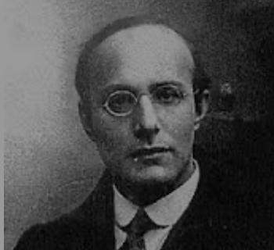
Popular Government and the Market Economy: Society’s Revenge
Karl Polanyi:
In a market economy, the only rights a market society respects are property rights:
& the only property rights that are worth anything are those that help you produce things for which rich people have a serious jones
& a market economy produces change and upheaval
Creative destruction at a rate never before seen:
Remember: 1 year sees as much technological and organizational change as 50 years back in the agrarian age
Hence there will be anxiety—economic anxiety and uncertainty
Perhaps it can be papered over if economic growth is fast enough
But if not?
Society will have its revenge: it will protect itself against the market logic
Somehow, it will find a way—constructive or destructive, left or right
And political entrepreneurs seeking power, or seeking to advance cause not broadly popular in their own right, will take advantage…
2:15
Notes:
Karl Polanyi noted: In a market economy, the only rights a market society respects are property rights: & the only property rights that are worth anything are those that help you produce things for which rich people have a serious jones
Plus a market economy produces change and upheaval: creative destruction at a rate never before seen. Remember: 1 year sees as much technological and organizational change as 50 years back in the agrarian age.
Hence people who think that they have rights to the land they live on—that it be the stable community they expect—and rights that their labor be respected—be rewarded with the income that is appropriate—and that finance be obtainable—that the decision of some sharp-eyed or sharp-nosed rootless cosmopolite thousands of miles away should not make the business they work for dry up and blow away in an instant. But those are not rights that the market can satisfy.
Hence there will be anxiety—economic anxiety and uncertainty. Perhaps it can be papered over if overall economic growth is fast enough. But if not? Then people will feel betrayed: the system isn’t working.
And they will want to search for reasons why the system isn’t working. And they will form themselves into a society.
This society will have its revenge: it will protect itself against the market logic. Somehow, it will find a way—constructive or destructive, left or right.
And political entrepreneurs seeking power, or seeking to advance causes not broadly popular in their own right, will take advantage. And the easiest way to take advantage is to put forward a leader, ideally someone charismatic. And they will promise that the leader will protect them from the enemies who are keeping the system from working, for he hates your enemies too and is working to overthrow them, as you would wish to.
This is not a recipe for a growth-enhancing technocratic politics, to say the least.
This can be a mask for plutocracy. This can be a cover for kleptocracy. This can be a motivating force for a broad welfare-enhancing populism. This can fuel the leader-worship of a neo-fascism, or of a movement that is not “neo”.

Slide 13
The End of the Long American Century
And so we come to a sea-change:
The end of the long 20th century in November, 2016
The end of the era of modern economic growth as we have known it
Globalization
Technological advance
U.S. leadership
U.S. becomes a chaos monkey
Not even a monkey seeking advantage
Trumpism:
As suspicion
As exclusion
A “Pete Wilson moment”
America, and democracy, in default. Workout? Recapitalization? Liquidation?
4:00
Notes:
And the world of slow productivity growth, deep recession, slow recovery, rapidly growing income and wealth inequality, plus the decline of markers of a superior social status that used to provide enormous psychic income to the properly white and manly male—in this world the Polanyian perplex cannot be papered over without trouble leaking through. And so we come to a sea change.
The long twentieth century came to an end in November, 2016, when the U.S. polity and government turned its back on the globalized world it had done so much to create, and became, instead, a chaos monkey. It was not even that the U.S. shifted its view of what its national interest required, and how the world should be managed. It gave up the idea of being a leader in global management, or keeping its word, or, indeed have having a coherent sense of what its national and the global interest might require.
To the extent that the Donald Trump administration had a worldview when it took office, it would be one of suspicion: that internal and external enemies, people of non-white race and non English-speaking language, were somehow taking advantage. These enemies needed to be kept off balance, somehow. And keeping them off-balance required that America put itself off-balance too.
To the extent that there were policies, they consisted of another round of tax-cuts-for-the-rich to further widen income inequality, another round of delay before tackling global warming, random regulatory rollbacks uninformed by technocratic calculation of benefits and costs—and cruelty: usually through the demonization of immigrants and foreigners, but cruelty as a strategy for the assertion of some kind of dominance.
The hope of Trump’s domestic opponents was that this would prove to be a “Pete Wilson moment”. Pete Wilson was the Governor of California who had sought to win reelection in the 1990s by demonizing California’s Hispanic immigrants as cheaters grabbing resources to which they were not fairly entitled and draining the state. Wilson won. But in the aftermath a large majority of California’s electorate decided that that was not who they wanted to be. And governance in California returned to normal, and then took two steps to the left: betting the future of the state on diversity, technology, and reinvigorated social democracy.
Whether the Trump administration, plus the American Republican Party’s decision to double-down in support for the Trump administration, will mark a similar watershed is in the hands of the American electorate, and of the judges who can either work to keep elections free and fair or put their thumbs on the scale. But what is certain is that all around the world, everybody knows that U.S. governance is broken, and that allowing the U.S. to take the lead on any global issue is to put a great deal at hazard.
And not only the U.S., but democracy has been placed in default. What happens after the default is not clear. Is there a workout—a buckling down and a period of privation, rededication, and probation, after which the old order is restored? Is there a recapitalization—or a new group brought in to manage the old enterprise and become the principal marginal stakeholders to take the old enterprise on a new course? Or is there simply a liquidation—an end of the America that thought itself exceptional as we have known it?
The future is in someone’s hands. It is not clear whose…

Slide 14
Big Ideas: Lecture 24: Populism, Plutocracy, Kleptocracy, & Neo-Fascism
Takeaways from this class:

Slide 15
Roadmap for the Next Two Weeks…
25. Th Apr 30: 6.4. Global Warming
Read Before: Melissa Dell et al. (2012): Temperature Shocks & Economic Growth: Evidence from the Last Half Century <https://scholar.harvard.edu/files/dell/files/aej_temperature.pdf>
Read Before: Melissa Dell et al. (2014). What Do We Learn from the Weather? The New Climate-Economy Literature, selections <https://economics.mit.edu/files/9138>
26. Tu May 5: 6.5. The Pace and Meaning of Economic Growth
Read Before: William Nordhaus: Do Real-Output and Real-Wage Measures Capture Reality? <https://www.nber.org/chapters/c6064.pdf>
Read Before: John Maynard Keynes: Economic Possibilities for Our Grandchildren<<https://delong.typepad.com/files/keynes-persuasion.pdf>
Read Before: Edward Bellamy (1887): Looking Backward 2000-1887, selections <https://delong.typepad.com/files/bellamy-backward.pdf>
7. Conclusion
27. Th May 7: 7.1. The Future?
Read Before: Robert Allen (2011): Global Economic History: A Very Short Introduction, selections <https://delong.typepad.com/files/allen-geh.pdf>

Slide 16
Catch Our Breath…
Ask a couple of questions?
Make a couple of comments?
Any more readings to recommend?

Slide 17
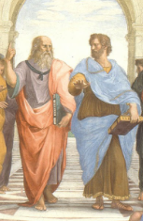
Notes, etc.…

Slide 18

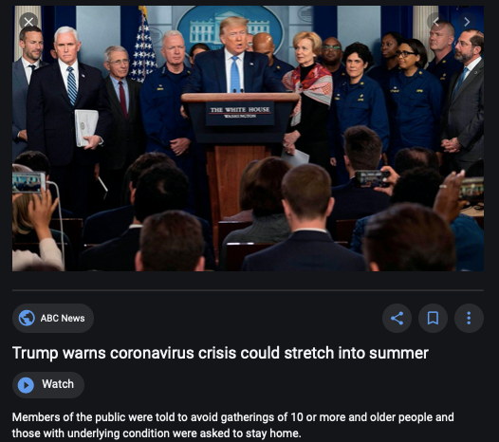
Coronavirus!

Slide 19
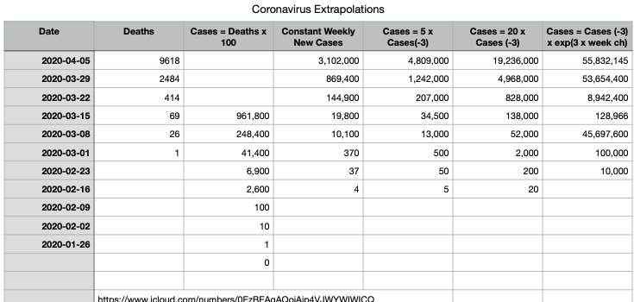
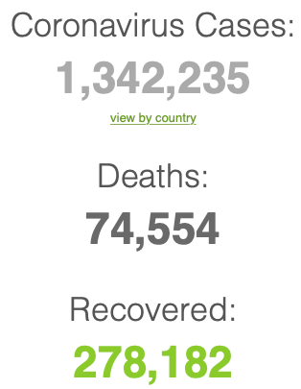
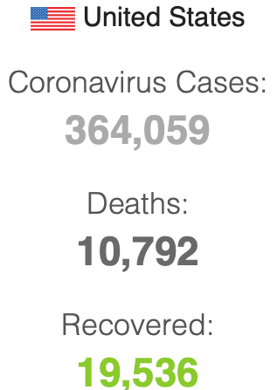

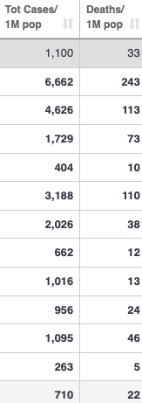
Coronavirus
Where we think we are, as of Th Apr 09:
We really do not know
No random samples…
If we extrapolate out the past week straight-line log:
We will have 440,000 deaths in three weeks
But it is unlikely to be that bad
Best thing I have read comes from Jim Stock <https://drive.google.com/file/d/12MV466ZZy5xHir4xdPhoTrL1oO8CbZU-/view>:
The basic SIR epidemiological model of contagion
The effect of social distancing and business shutdowns on epidemic dynamics enters the model through a single parameter: the case transmission rate β
Re-express the model in terms of β and the asymptomatic (or not very symptomatic) hence non-tested rate—the fraction of the infected who are not tested
The COVID-19 non-testing rate is unidentified in our model
Estimates in the epidemiological literature range from 0.18 to 0.86.
The asymptomatic rate could be estimated accurately and quickly by testing a random sample
The optimal policy response and its economic consequences hinge critically on the asymptomatic rate

Slide 20
Coronavirus II
We do not really know where we are, as of Mo Apr 6:
Best thing I have read comes from Jim Stock <https://drive.google.com/file/d/12MV466ZZy5xHir4xdPhoTrL1oO8CbZU-/view>:
The basic SIR epidemiological model of contagion
The effect of social distancing and business shutdowns on epidemic dynamics enters the model through a single parameter: the case transmission rate β
Re-express the model in terms of β and the asymptomatic (or not very symptomatic) hence non-tested rate—the fraction of the infected who are not tested
The COVID-19 non-testing rate is unidentified in our model
Estimates in the epidemiological literature range from 0.18 to 0.86.
The asymptomatic rate could be estimated accurately and quickly by testing a random sample
The optimal policy response and its economic consequences hinge critically on the asymptomatic rate

Slide 24

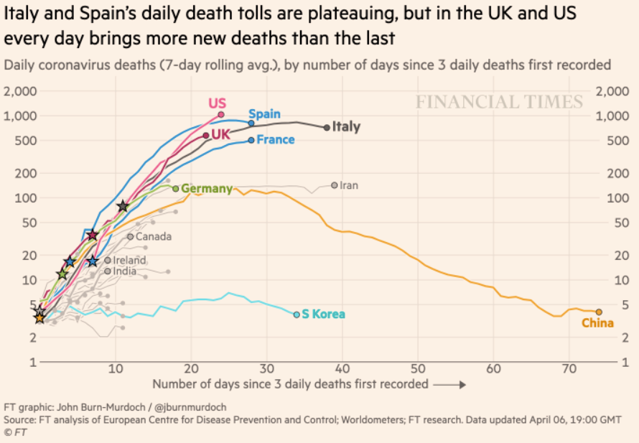
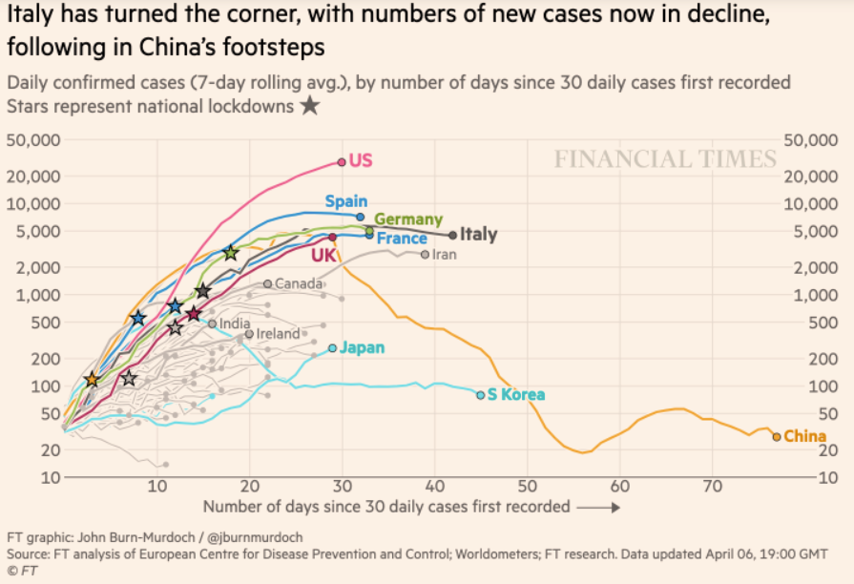
Financial Times Graphs Blown Up…

Slide 28
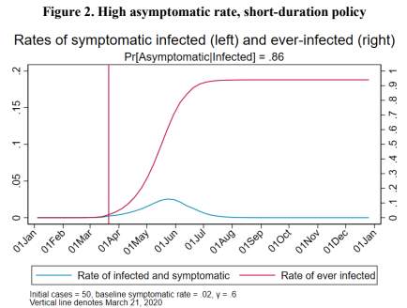
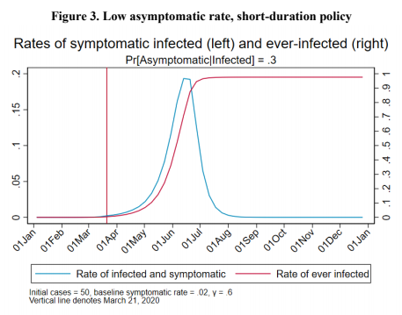
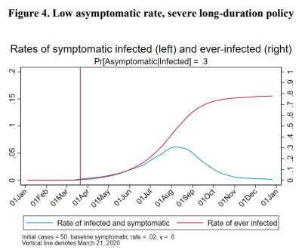
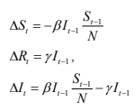
James Stock (2020)
Standard SIR model:<https://drive.google.com/file/d/12MV466ZZy5xHir4xdPhoTrL1oO8CbZU-/view>:
Susceptible, Infected, Recovered (& immune), transmission rate β, recovery rate γ, reproduction number R0, asymptomatic hence non-tested rate π0
Calibration: half-life of infection one week: γ = 0.5, s0 = 0.02, 50 cases on Jan 24
For March 21, 2020, the positive test rate in the United States is approximately 10%…
<https://drive.google.com/file/d/12MV466ZZy5xHir4xdPhoTrL1oO8CbZU-/view>

Slide 33
Bringing the Economy Back Up from Anæsthesia
Major issues:
Certificates of immunity:
Which requires test, test, test:
And not just disease virus tests
Presence-of-antibodies tests
How quickly can we match the immune with public-contact jobs?
What jobs can be done with minimal infection risk?
What minimal-infection substitutes can we find for previous jobs?
How quickly can restrictions be relaxed without the virus coming roaring back?
How do we avoid having the market give a “shutdown” signal to enterprises we in fact want restarted?
Which is pretty much all of them
How much of the potential caseload do we want to push out beyond the vaccine-arrival date?
ALL THESE QUESTIONS ARE ANSWERABLE IF WE LEARN THE ASYMPTOMATIC HENCE NON-TESTED RATE!!

Slide 34
Keeping the Economy from Crashing During the Lockdown
Nick Rowe: We have a 50% output cut in 100% of the sectors:
A temporary 100% output cut in 50% of the sectors (what the Coronavirus does) is very different from a 50% output cut in 100% of the sectors
Nick’s thought experiment:
In three months we are going to invent unobtanium:
Substantial intertemporal substitutibility
Plus lower cross-good contemporaneous substitutitbility
Hence high desired savings rate now
Flex-price market thus produces a nominal rate at the zero lower bound and a high inflation rate over the next three to six months
Plus liquidity-constrained workers in affected sectors see their demand go to zero immediately
Can we get there? Should we get there? What should we do instead?
We need a good RBC economist: are there any?…
<https://worthwhile.typepad.com/worthwhile_canadian_initi/2020/03/relative-supply-shocks-unobtainium-walras-law-and-the-coronavirus.html>

Slide 35
Keeping the Economy from Crashing During the Lockdown II
Nick Rowe:
<https://worthwhile.typepad.com/worthwhile_canadian_initi/2020/03/relative-supply-shocks-unobtainium-walras-law-and-the-coronavirus.html>
Plus: to extend the thought experiment:
We just lost the ability to make “unobtainium”
So we should be substituting leisure for work, and moving workers into relatively unproductive labor, making the commodities we can still produce right now
How should relative prices move as a result? How should we make them move?
Plus: distributional issues
Plus: bankruptcy and credit chain issues

Slide 36
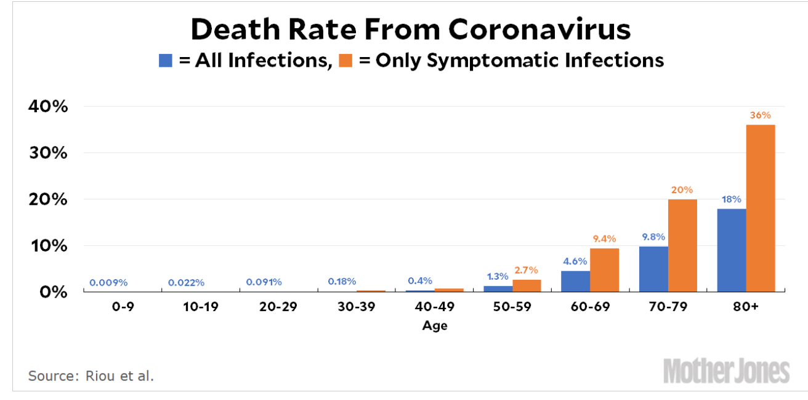
MOAR Coronavirus!
Death for Geezers!
Mortality for the Youngs very low…
It’s the flu for them—for you…
And an extra doubling—or is it 5%?—mortality for the asthmatic
And an extra doubling—or is it 5%?—mortality for the overweight

Slide 37
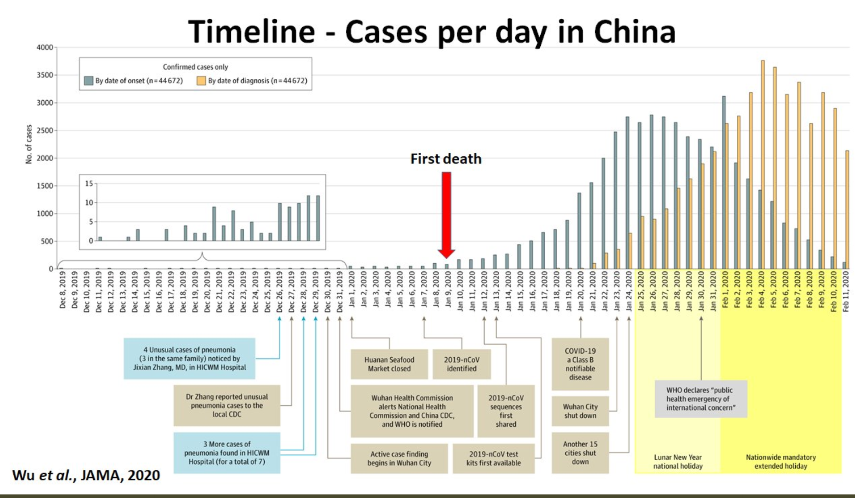
What We Think Happened in Wuhan
China beat it quickly & relatively easily!
We think
Shut down Wuhan when 200 cases per day
That seems to have been a good decision

Slide 38

The Goal
When Is It Appropriate to Move on This?
Immediate social distancing…
Self-isolate if you have a cough and a fever…
Hope that warmer temperatures will do to this what they did to SARS…
Otherwise, when do you want to start spreading out transmission. It seems that early is as good as later, so do it early…
I have no good intuition on why you want to move early
Plus your moving early will be wasted if you get reinfected
Plus the sparks you throw off making others’ lives more difficult

Slide 39
References
Financial Times (2020): Coronavirus Tracked: The Latest Figures as the Pandemic Spreads <https://www.ft.com/coronavirus-latest>
Nick Rowe (2020): Relative Supply Shocks, Unobtainium, Walras' Law, and the Coronavirus <https://worthwhile.typepad.com/worthwhile_canadian_initi/2020/03/relative-supply-shocks-unobtainium-walras-law-and-the-coronavirus.html>
Jim Stock (2020): Coronavirus Data Gaps and the Policy Response <https://drive.google.com/file/d/12MV466ZZy5xHir4xdPhoTrL1oO8CbZU-/view>

Slide 40
MOAR Coronavirus!
What I am watching:
Max Roser & Hannah Ritchie: Coronavirus Disease (COVID-19) <https://ourworldindata.org/coronavirus>…
Worldometer: Coronavirus Update (Live) <https://www.worldometers.info/coronavirus/>: ‘125,599 Cases and 4,605 Deaths from COVID-19 Virus Outbreak…
FT Coronavirus Tracker <https://www.ft.com/content/a26fbf7e-48f8-11ea-aeb3-955839e06441>
Josh Marshall’s COVID Twitter List <https://twitter.com/i/lists/1233998285779632128>
NEJM Group: Updates on the Covid-19 Pandemic <http://m.n.nejm.org/nl/jsp/m.jsp?c=%40kxNtXckRDOq8oG0jJvAXsIzN4mPECIPhltxoTSdTU9k%3D&cid=DM89089_NEJM_COVID-19_Newsletter&bid=173498255>: 'From the New England Journal of Medicine, NEJM Journal Watch, NEJM Catalyst, and other trusted sources...

Slide 41
Catch Our Breath…
Ask a couple of questions?
Make a couple of comments?
Any more readings to recommend?
<https://www.icloud.com/keynote/0YKEi7HeOrVGvKYtt9FEqH7nA>
<https://www.bradford-delong.com/2020/04/coronavirus.html>
github:<https://github.com/braddelong/public-files/blob/master/coronavirus.pptx>
https://github.com/braddelong/public-files/blob/master/coronavirus.pdf>
html File: <https://www.bradford-delong.com/2020/04/coronavirus.html>
Edit This File: <https://www.typepad.com/site/blogs/6a00e551f08003883400e551f080068834/post/6a00e551f080038834025d9b3bd66a200c/edit>
<https://delong.typepad.com/files/2020-04-01-coronavirus.pdf>

Slide 42
Coronavirus! (March 16)
With 31 deaths in the U.S. as of March 11, a 1% death rate, and up to 4 weeks between infection and death, that means that as of Feb 12 there were 3100 coronavirus cases in the United States.
With 87 deaths in the U.S. as of Mar 16, a 1% death rate, and up to 4 weeks between infection and death, that means that as of Feb 17 there were 8700 coronavirus cases in the United States
If it is doubling every seven days, then now about 150,000 people have and in the next week about 150,000 more people in the U.S. will catch coronavirus—which means 1/2200, currently 3500 of the 7.6 million inhabitants of San Francisco Bay. Touch a hard surface that any of those 3500 has touched in the last 48 hours, and the virus has a chance to jump to you…
These numbers could be five times too big. These numbers are probably not five times too small unless the thing is a lot less deadly, and there are a lot of asymptomatic cases…
What is wrong with this analysis?

Slide 43
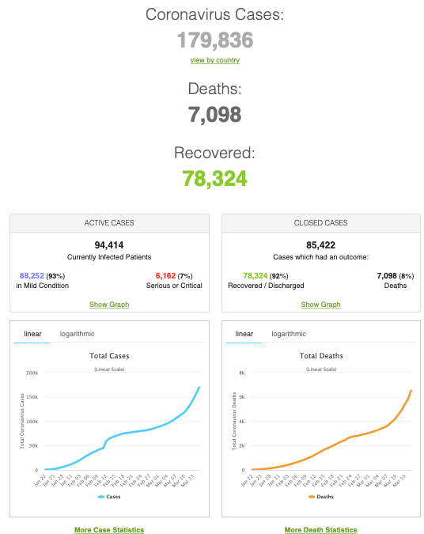
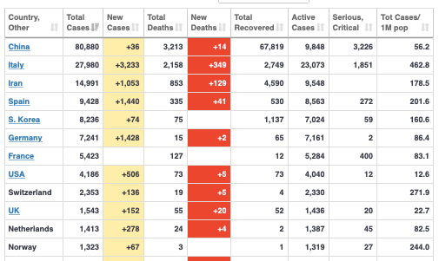
MOAR Coronavirus!
As of March 21: Things are not moving in the right direction:
What is the R0?
How can the R0 be changed?
How will the R0 change?
What is the asymptote share of the population?
What is the mortality rate?

Slide 44
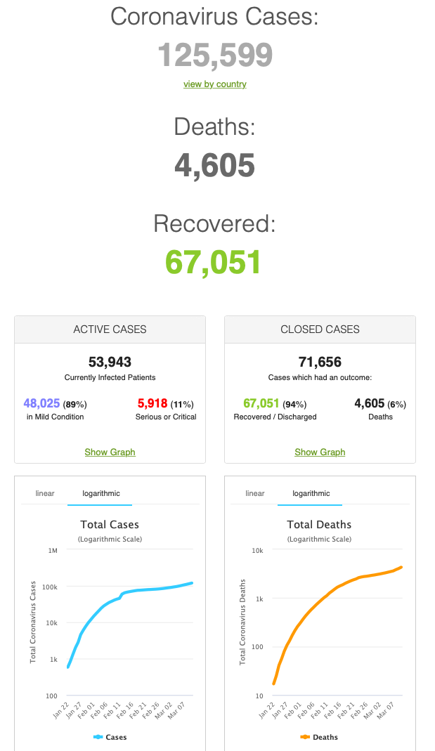
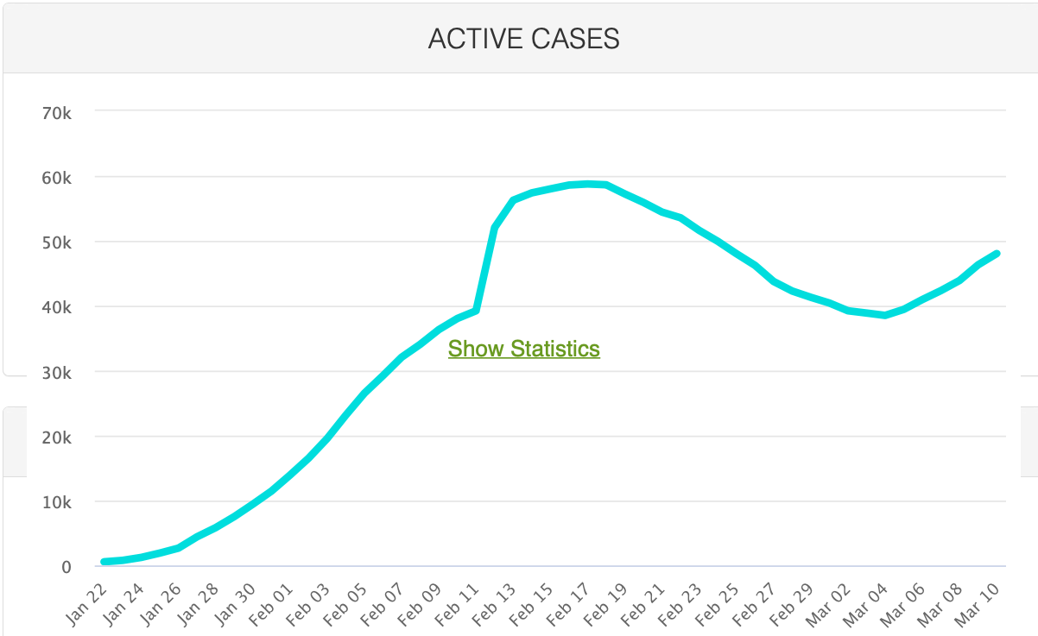
MOAR Coronavirus!
As of March 10: Things are not moving in the right direction:
What is the R0?
How can the R0 be changed?
How will the R0 change?
What is the asymptote share of the population?
What is the mortality rate?

Slide 45
Notes

